Slide 1
Spoken digit recognition with photorefractive SOLO
Mark Cronin-Golomb
Department of Biomedical Engineering
Tufts University

Slide 2
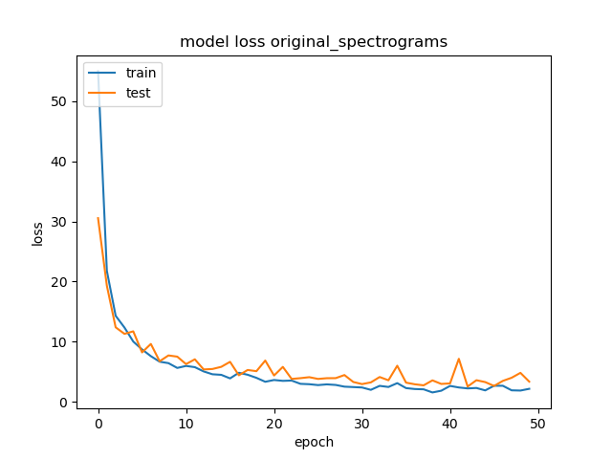
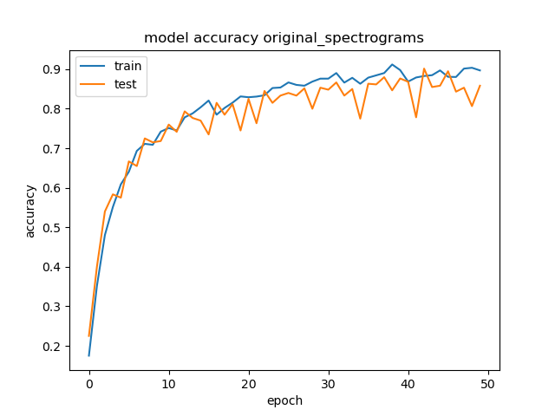
Original spectrograms
Accuracy to 0.8~0.9

Slide 3
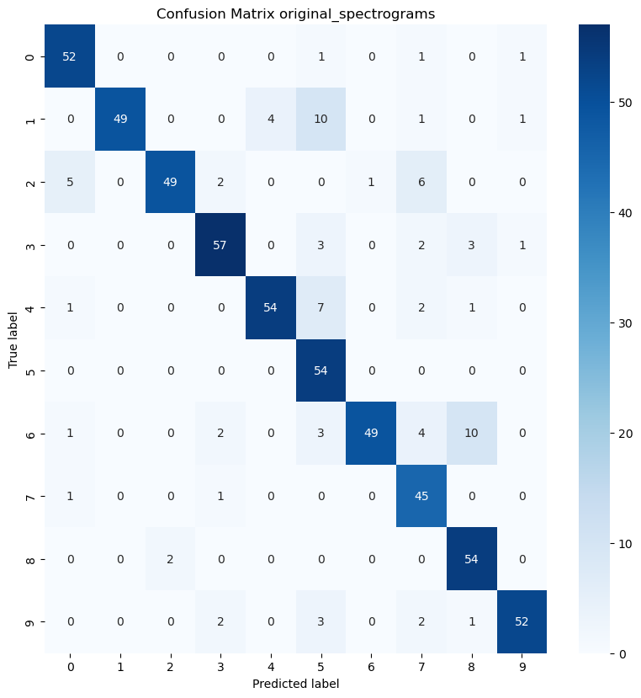
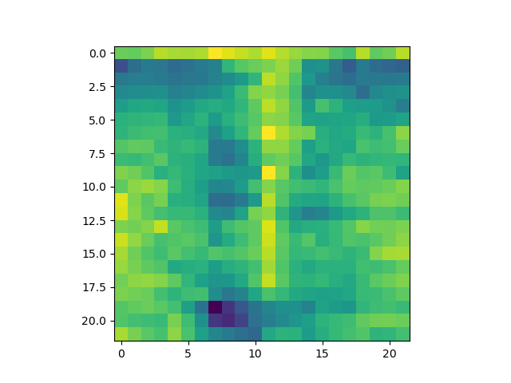

Slide 4
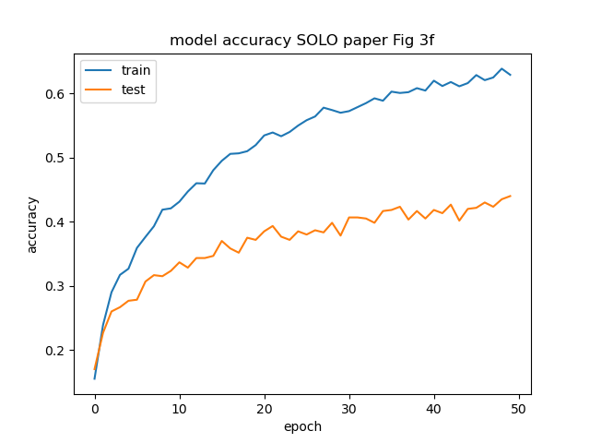
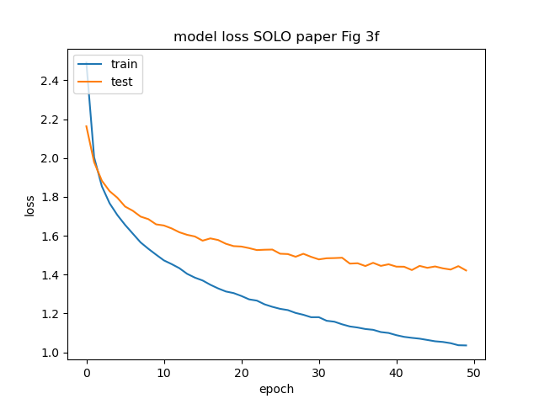
SOLO paper Fig 3f

Slide 5
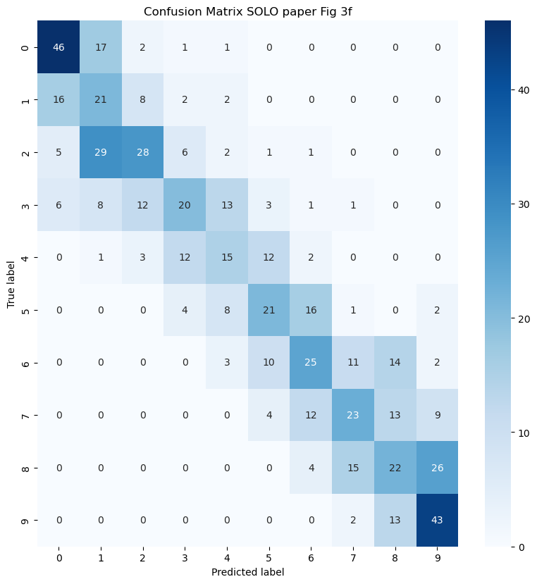
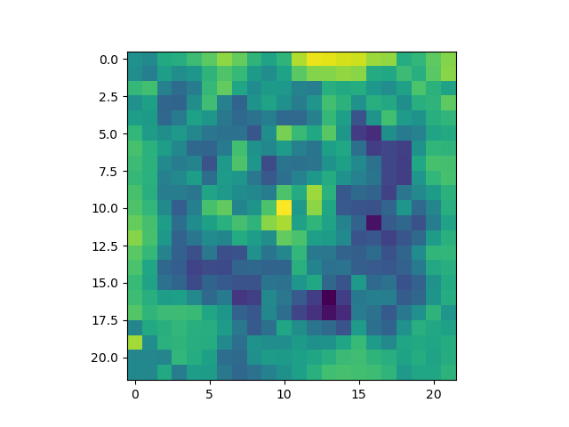

Slide 6
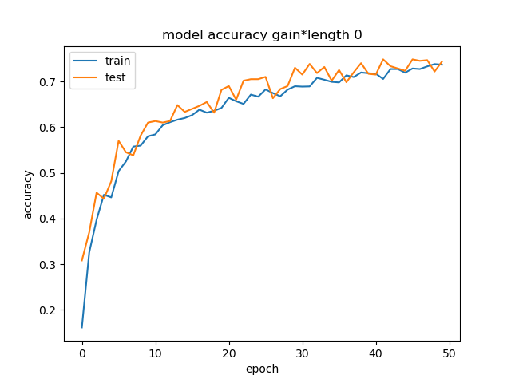
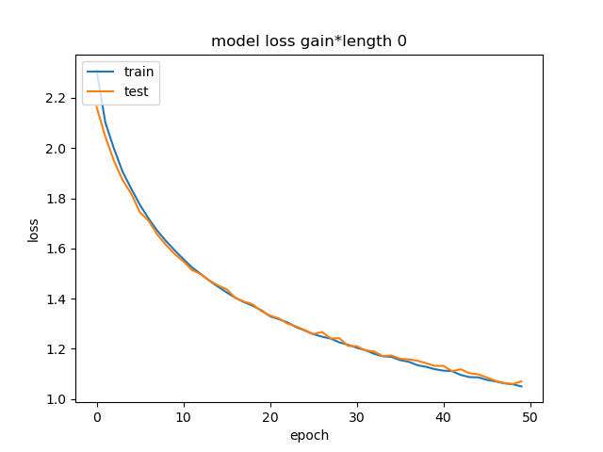
Photorefractive coupling constant x length: 0

Slide 7
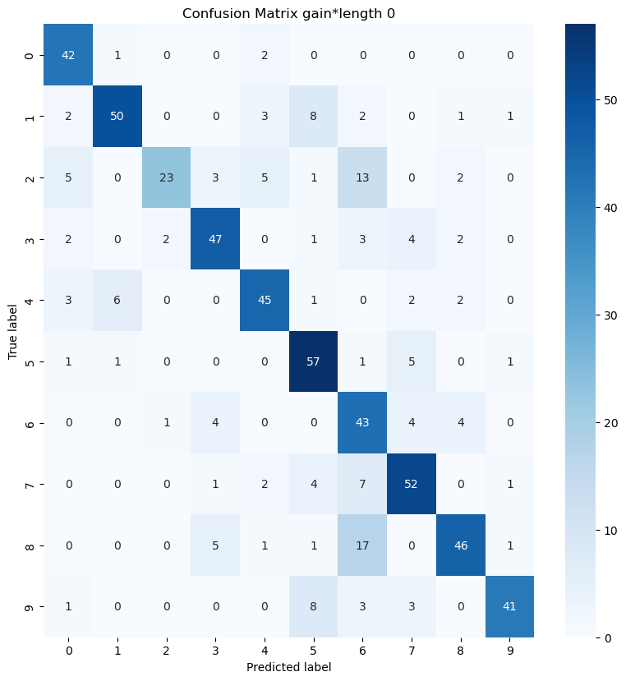
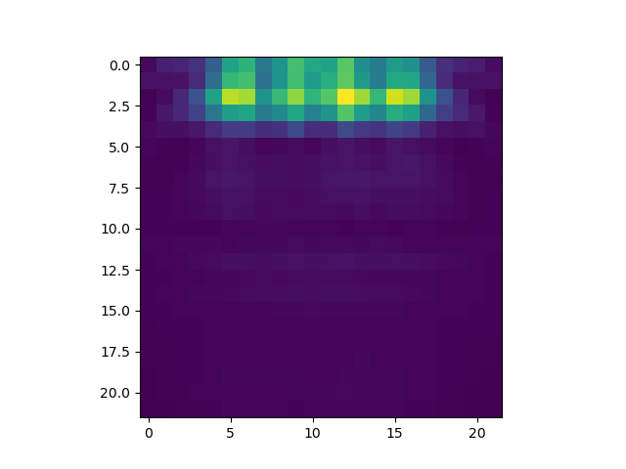

Slide 8
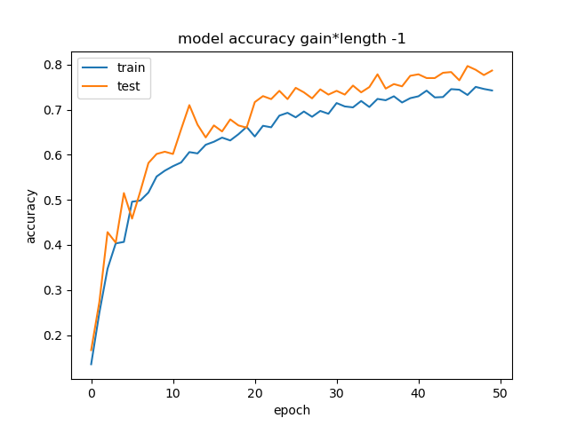
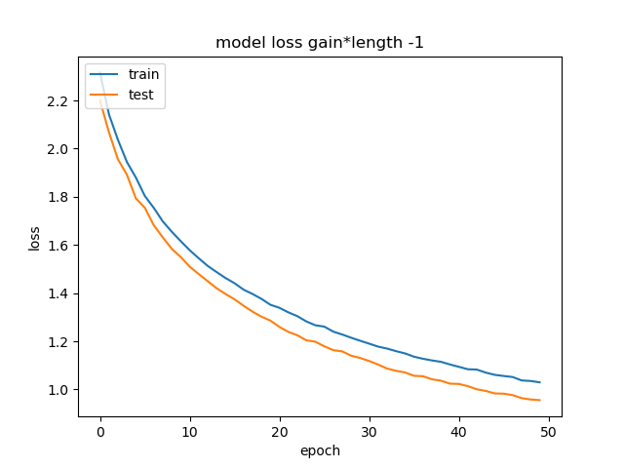
Photorefractive coupling constant x length: -1

Slide 9
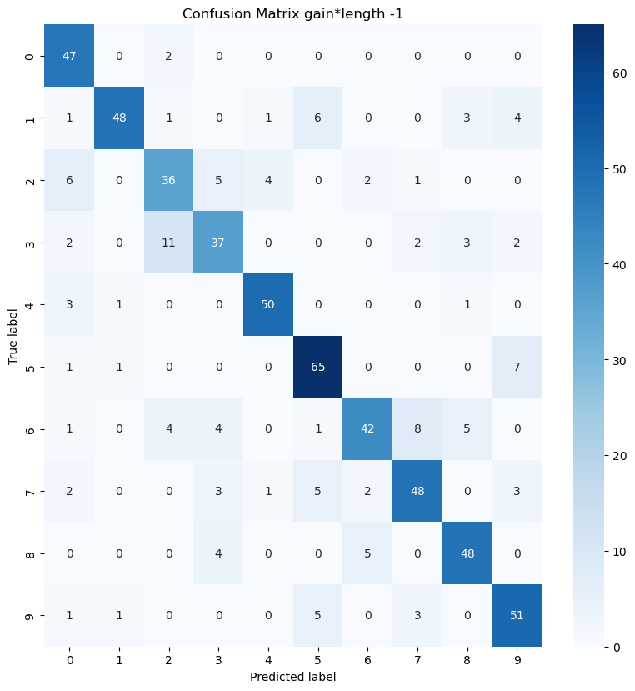
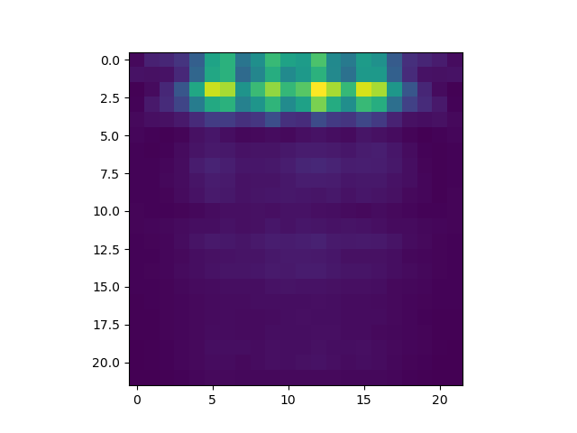

Slide 10
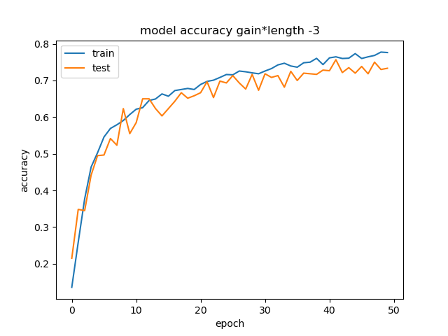
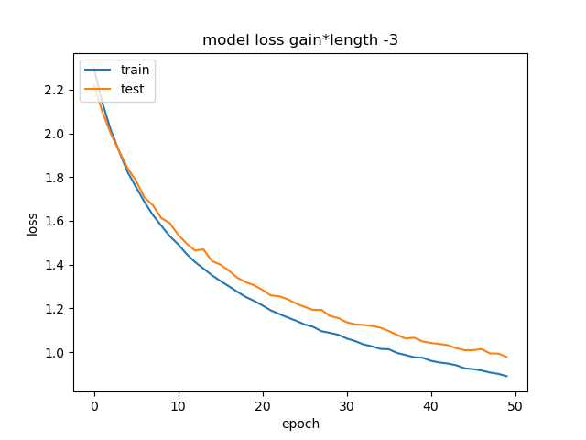
Photorefractive coupling constant x length: -3

Slide 11
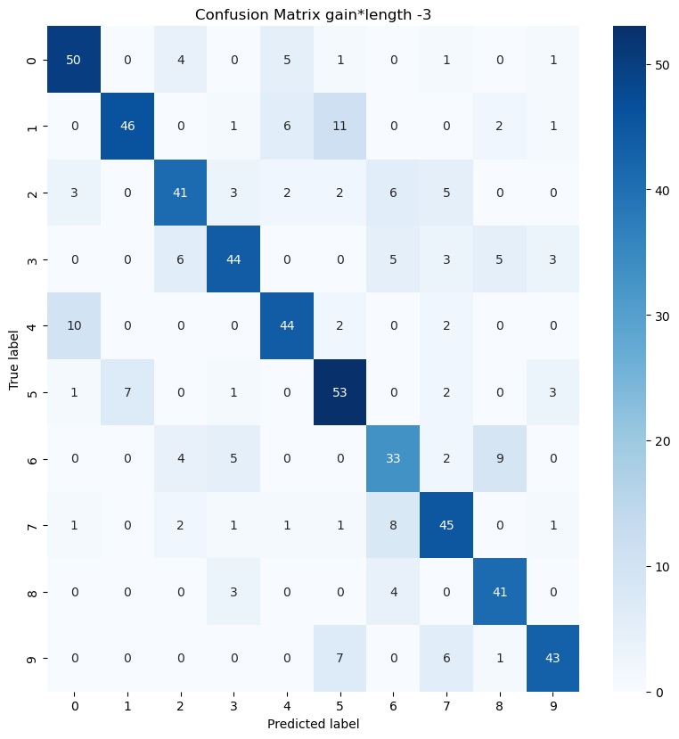
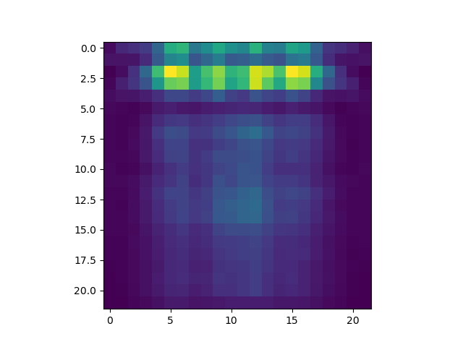

Slide 12
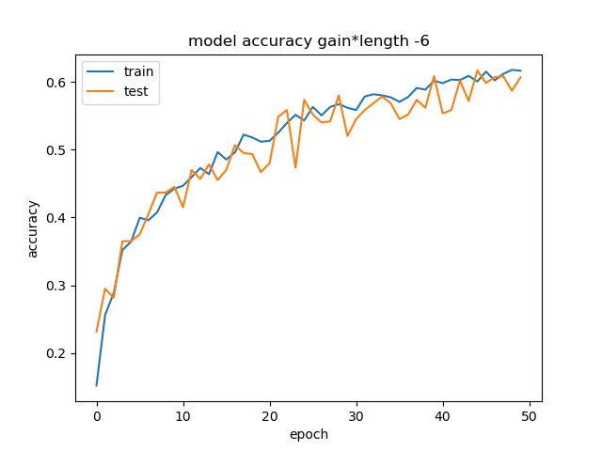
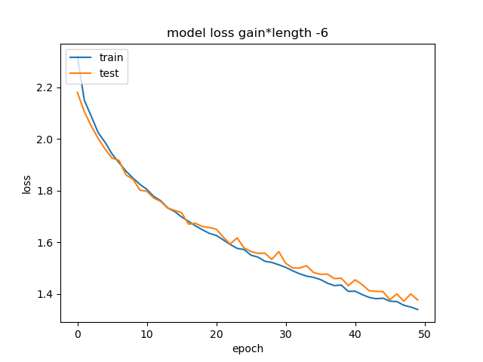
Photorefractive coupling constant x length: -6

Slide 13
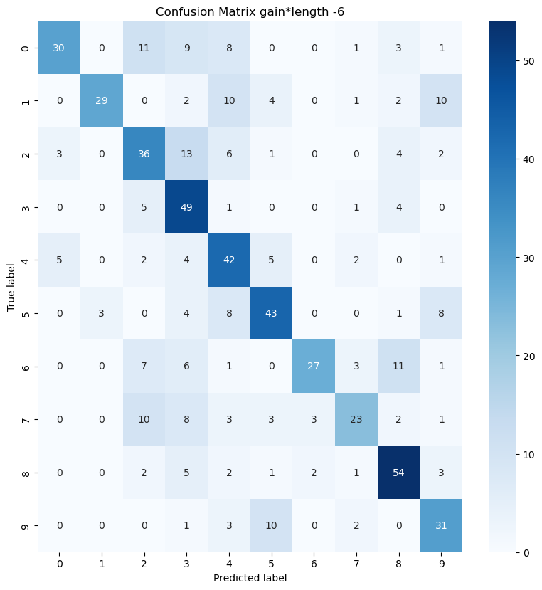
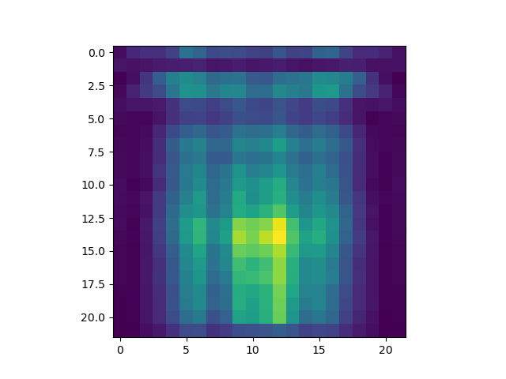

Slide 14
Input type | Accuracy after 50 iterations: training data | Accuracy after 50 iterations: test data
original spectrograms | 0.92 | 0.90
SOLO paper data for Fig 3f | 0.65 | 0.44
Photorefractive γl = 0 | 0.74 | 0.76
Photorefractive γl = -1 | 0.76 | 0.72
Photorefractive γl = -3 | 0.77 | 0.72
Photorefractive γl = -6 | 0.61 | 0.59

